Slide 1

MODELLED ALNS
Francesco Baioni
Cristian Cingolani

Slide 2
Topics
Objectives
Mere ALNS
Modelled ALNS
Database
Results
Visualization of trees
Conclusions

Slide 3
Objectives
Development of eighteen DT-models based on respective algorithms used to repair/destroy customer and stations within an iteration of the mere ALNS
Implementation of the eighteen models within the ALNS code
Comparison of the two solutions: on one hand the mere ALNS while on the other hand the modelled ALNS, which is supposed to be better performing

Slide 4
Mere ALNS
Extension of Large Neighborhood Search (LNS), that does not commit to one destroy and repair heuristic, but it chooses in every iteration from a pool of heuristics based on past success (adaptive)
The goal is to find the optimal solution that minimizes the costs, often referred to it as distance between nodes or time with which the customers have been served
For this implementation, every iteration is applied a customer repair and destroy method within the ones available; then every five iterations station repair and destroy are chosen

Slide 5
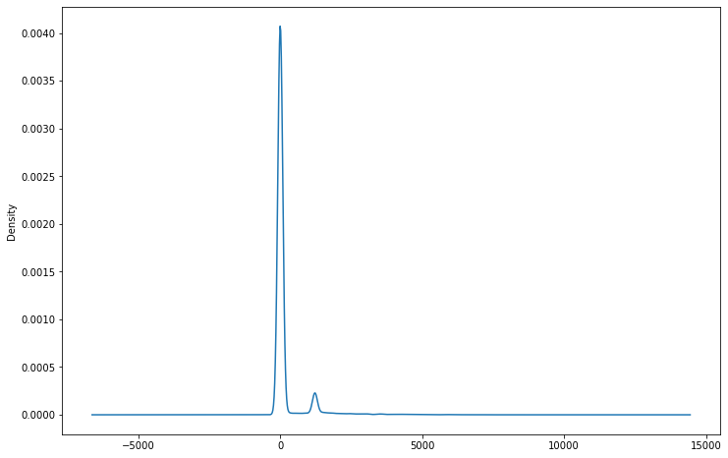
Modelled ALNS - Database
With the aim of training the eigtheen models, running the mere-ALNS code, every iteration with all his variables has been saved as a record within a CSV file for a total of 21158 rows
Following, the distribution of
the OF_Diff (difference between initial and final OF) attribute:

Slide 6
Modelled ALNS - Database
Then, an algorithm-based filtering has been applied in order to obtain a sub-db for every moves that the ALNS can apply for repair and destroy. For each of those, has been calculated the difference between OFIS and OFFS, so that the final label could be applied to the record
Three classification approaches used:
Binary: Bad/Good
3-Way: Bad/Good/Very Good
4-Way: Bad/Normal/Good/VeryGood

Slide 7
Modelled ALNS
Respecting the main objective of this project, eighteen models have been trained through random forest techniques producing graphs with the following fields:
OFIS, OFFS, Exe_Time_d-r, Avg_Battery_Status,Avg_SoC, Avg_Num_Charge, Avg_Vehicle_Capacity, Avg_Customer_Demand, Num_Vehicles, Avg_Service_Time, Avg_Customer_TimeWindow, Var_Customer_TimeWindow, Avg_Customer_customer_min_dist, Var_Customer_customer_min_dist, Avg_Customer_station_min_dist, Var_Customer_station_min_dist, Avg_Customer_deposit_dist, Var_Customer_deposit_dist
Lastly, each model was used to produce a prediction and, from the best of them, one algorithm of destroy and repair was chosen, for each iteration
(Seed 123 and Seed 42)

Slide 8
Modelled ALNS
BINARY
RandomDestroyStation | Acc: 0,946 |  |  | 148 |  | 16
 |  |  | 3 |  | 183
 | Precision | Recall |  | F1-score |  | support
Bad | 0,98 | 0,90 |  | 0,94 |  | 164
Good | 0,92 | 0,98 |  | 0,95 |  | 186
Some statistics of the train-test phase
LongestWaitingTimeDestroyStation | Acc: 0,939 |  |  | 115 |  | 6
 |  |  | 8 |  | 100
 | Precision | Recall |  | F1-score |  | support
Bad | 0,93 | 0,95 |  | 0,94 |  | 121
Good | 0,94 | 0,93 |  | 0,93 |  | 108
BINARY
Bad | <= 1
Good | > 1
DeterministicBestRepairStation | Acc: 0,977 |  |  | 139 |  | 7
 |  |  | 0 |  | 155
 | Precision | Recall |  | F1-score |  | support
Bad | 1 | 0,95 |  | 0,98 |  | 146
Good | 0,96 | 1 |  | 0,98 |  | 155

Slide 9
Modelled ALNS
3-WAY
RandomDestroyStation | Acc: 0,949 |  |  | 14 |  | 1 |  | 0
 |  |  | 1 |  | 11 |  | 0
 |  |  | 0 |  | 0 |  | 12
 | Precision | Recall |  | F1-score |  | support
Bad | 0,93 | 0,93 |  | 0,93 |  | 15
Good | 0,92 | 0.92 |  | 0,92 |  | 12
V.Good | 1,00 | 1,00 |  | 1,00 |  | 12
Some statistics of the train-test phase
LongestWaitingTimeDestroyStation | Acc: 0,786 |  |  | 8 |  | 2 |  | 0
 |  |  | 0 |  | 5 |  | 2
 |  |  | 0 |  | 2 |  | 9
 | Precision | Recall |  | F1-score |  | support
Bad | 1,00 | 0,80 |  | 0,89 |  | 10
Good | 0,56 | 0,71 |  | 0,63 |  | 7
V.Good | 0,82 | 0,82 |  | 0,82 |  | 11
3-WAY
Bad | <= 0
Good | > 0 && <= 1500
Very Good | > 1500
DeterministicBestRepairStation | Acc: 0,871 |  |  | 11 |  | 1 |  | 0
 |  |  | 0 |  | 5 |  | 3
 |  |  | 0 |  | 0 |  | 11
 | Precision | Recall |  | F1-score |  | support
Bad | 1,00 | 0,92 |  | 0,96 |  | 12
Good | 0,83 | 0,62 |  | 0,71 |  | 8
V.Good | 0,79 | 1,00 |  | 0,88 |  | 11

Slide 10
Modelled ALNS
4-WAY
RandomDestroyStation | Acc: 1,00 |  |  | 2 |  | 0 | 0 |  | 0
 |  |  | 0 |  | 3 | 0 |  | 0
 |  |  | 0 |  | 0 | 2 |  | 0
 |  |  | 0 |  | 0 | 0 |  | 2
 | Precision | Recall |  | F1-score |  |  | support
Bad | 1,00 | 1,00 |  | 1,00 |  |  | 2
Normal | 1,00 | 1,00 |  | 1,00 |  |  | 2
Good | 1,00 | 1,00 |  | 1,00 |  |  | 3
V.Good | 1,00 | 1,00 |  | 1,00 |  |  | 2
Some statistics of the train-test phase
4-WAY
Bad | <= 0
Normal | > 0 && <= 1500
Good | > 1500 && <= 3000
Very Good | > 3000
LongestWaitingTimeDestroyStation | Acc: 0,929 |  |  | 4 |  | 0 | 0 |  | 0
 |  |  | 0 |  | 1 | 1 |  | 0
 |  |  | 0 |  | 0 | 2 |  | 0
 |  |  | 0 |  | 0 | 0 |  | 6
 | Precision | Recall |  | F1-score |  |  | support
Bad | 1,00 | 1,00 |  | 1,00 |  |  | 4
Normal | 0,67 | 1,00 |  | 0,80 |  |  | 2
Good | 1,00 | 0,50 |  | 0,67 |  |  | 2
V.Good | 1,00 | 1,00 |  | 1,00 |  |  | 6

Slide 11
Results
ORIGINAL
BINARY
 | InitOF | FinalOF | DiffOF | Time
count | 1091.000000 | 1091.000000 | 1091.000000 | 1091.000000
mean | 46840.123732 | 37543.988802 | 9296.134930 | 4.411331
std | 23944.112227 | 22203.879593 | 9530.125884 | 4.110535
min | 8312.373013 | 3716.118542 | 0.000000 | 0.454569
25% | 27079.509976 | 17795.075508 | 2311.310744 | 1.222183
50% | 42020.455353 | 31176.313453 | 6552.821806 | 2.573590
75% | 64479.458794 | 54392.071192 | 12893.028528 | 6.973133
max | 116425.425166 | 96610.361991 | 55552.270849 | 26.456460
 | InitOF | FinalOF | DiffOF | Time
count | 1091.000000 | 1091.000000 | 1091.000000 | 1091.000000
mean | 46782.977939 | 37599.775844 | 9183.202095 | 4.468675
std | 24026.703183 | 22515.569895 | 9717.384409 | 3.925686
min | 5046.040396 | 2499.983522 | 0.000000 | 0.563701
25% | 27399.906993 | 17402.284021 | 2238.616278 | 1.358506
50% | 41977.408199 | 31009.661791 | 6238.131070 | 2.701153
75% | 64171.873397 | 54782.143466 | 12924.046322 | 7.197181
max | 114850.280259 | 95674.825868 | 52910.941437 | 26.888164
 | InitOF | FinalOF | DiffOF | Time
count | 1091.000000 | 1091.000000 | 1091.000000 | 1091.000000
mean | 45660.355984 | 37094.065160 | 8566.290824 | 3.552257
std | 23974.857470 | 22047.096890 | 9295.110196 | 2.973539
min | 6309.578772 | 1575.657787 | 0.000000 | 0.543078
25% | 26776.443466 | 18024.521431 | 1851.175119 | 0.905628
50% | 39805.208335 | 30716.330775 | 5748.383815 | 2.380537
75% | 63672.542695 | 52900.786344 | 11823.075617 | 6.024392
max | 116869.244634 | 96619.778184 | 49044.503331 | 16.559045
 | InitOF | FinalOF | DiffOF | Time
count | 1091.000000 | 1091.000000 | 1091.000000 | 1091.000000
mean | 46506.869404 | 37673.794825 | 8833.074579 | 4.408615
std | 24263.894308 | 22289.547359 | 9684.700113 | 4.164475
min | 5046.040396 | 1970.099430 | 0.000000 | 0.531571
25% | 26007.932549 | 18071.531024 | 2117.314395 | 1.099637
50% | 42179.816260 | 31632.370458 | 5810.069088 | 2.580411
75% | 64183.674407 | 53791.887764 | 11663.044569 | 6.867219
max | 116375.166730 | 95607.870804 | 55010.388829 | 35.290771
3 CLASSES
4 CLASSES

Slide 12
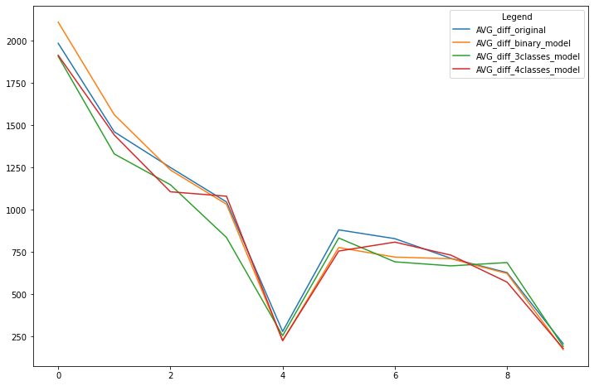
Results
AVG DIFF MODELS VS ORIGINAL
4 CLASSES
BINARY
3 CLASSES
Following, the comparison bewtween the run of the original ALNS code with the modelled ones:

Slide 13
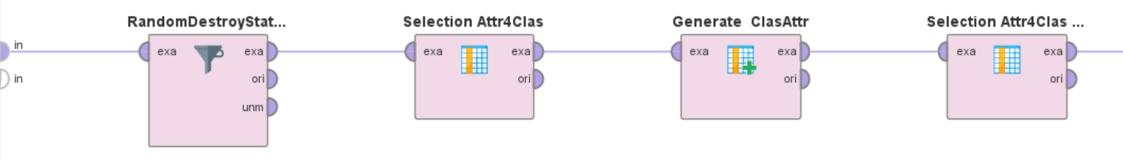
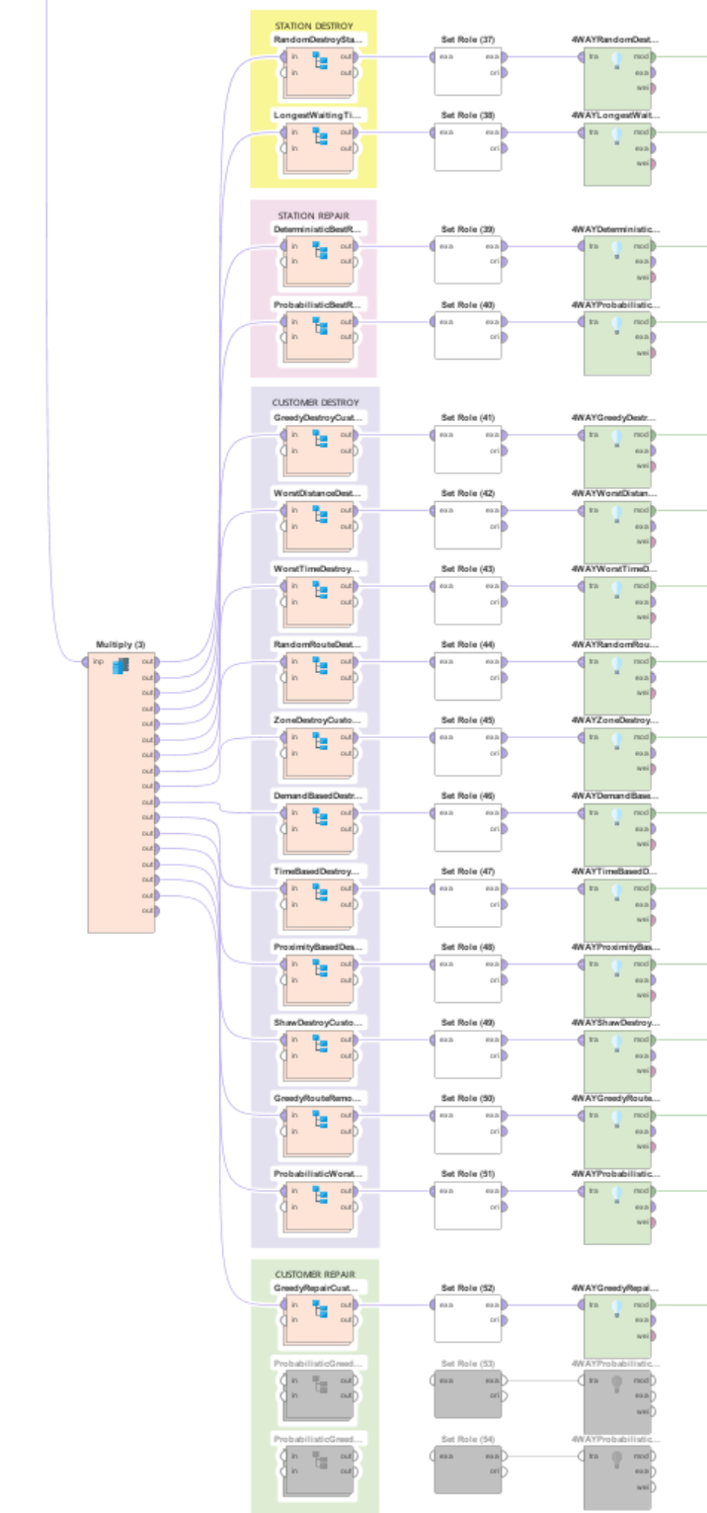
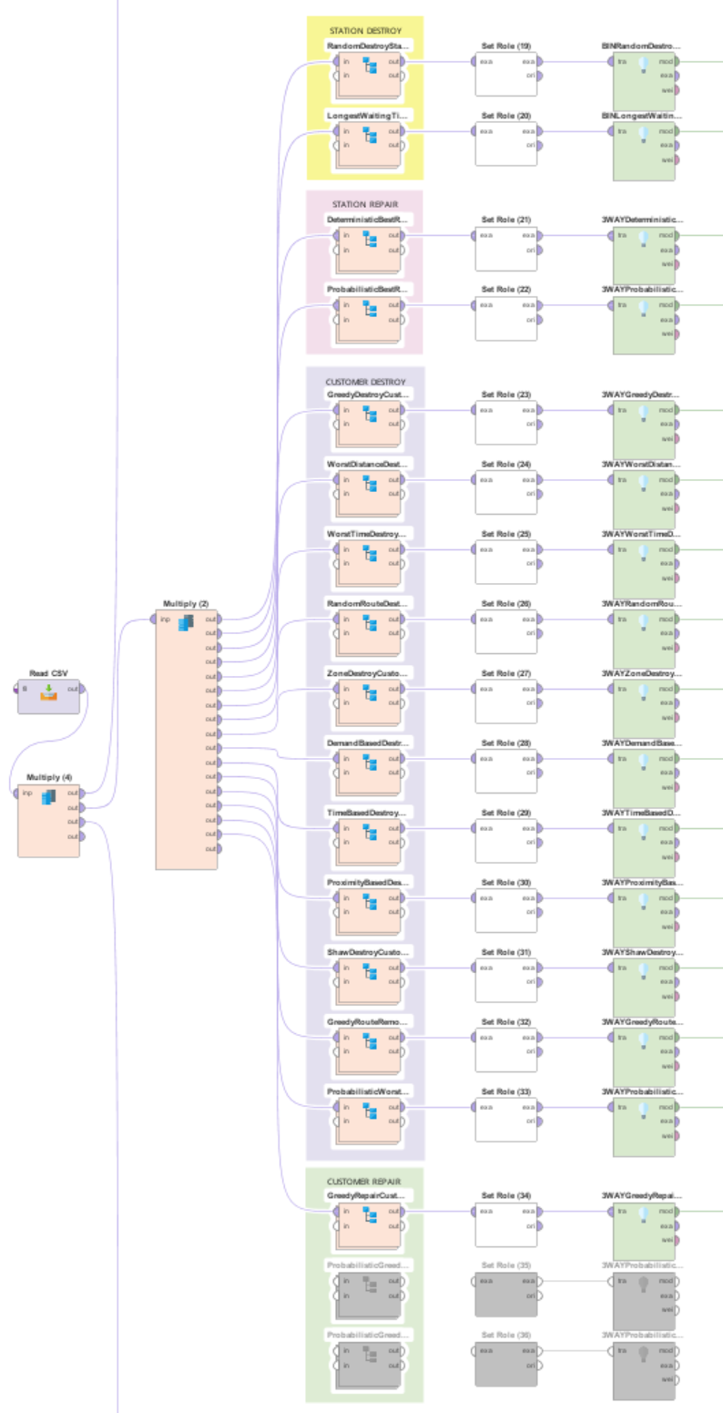
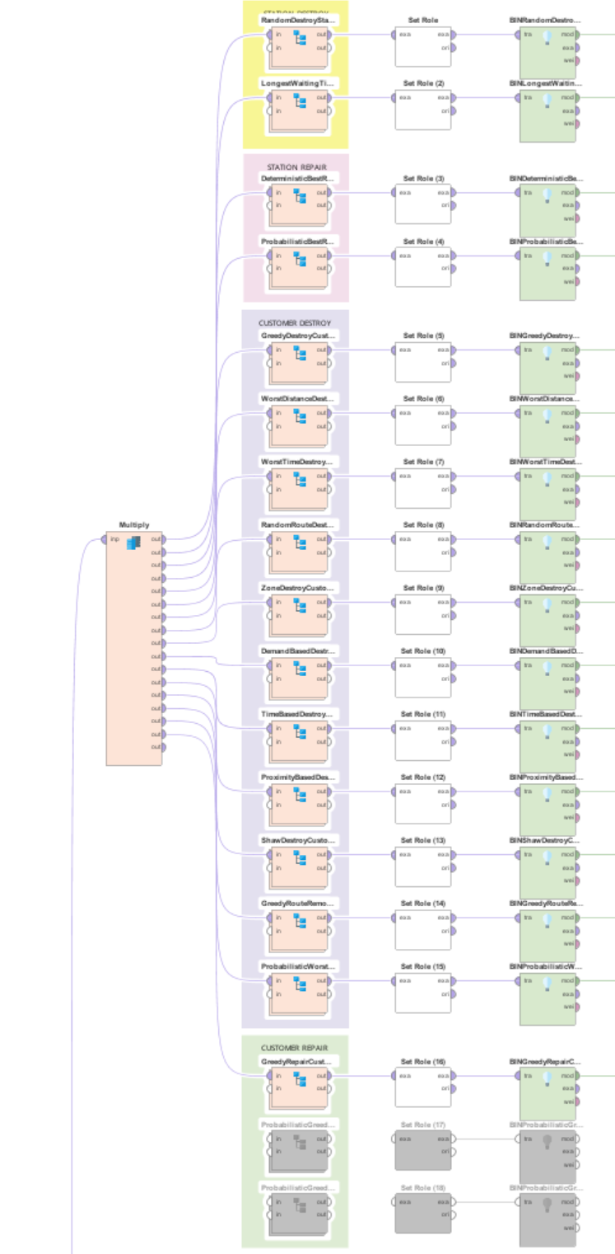
Visualization of trees
Subprocess
Due to the incapacity to view models using python libraries, rapid miner was used to create tree views of the random forest algorithm (same settings as python code)
BINARY
3-WAY
4-WAY

Slide 14
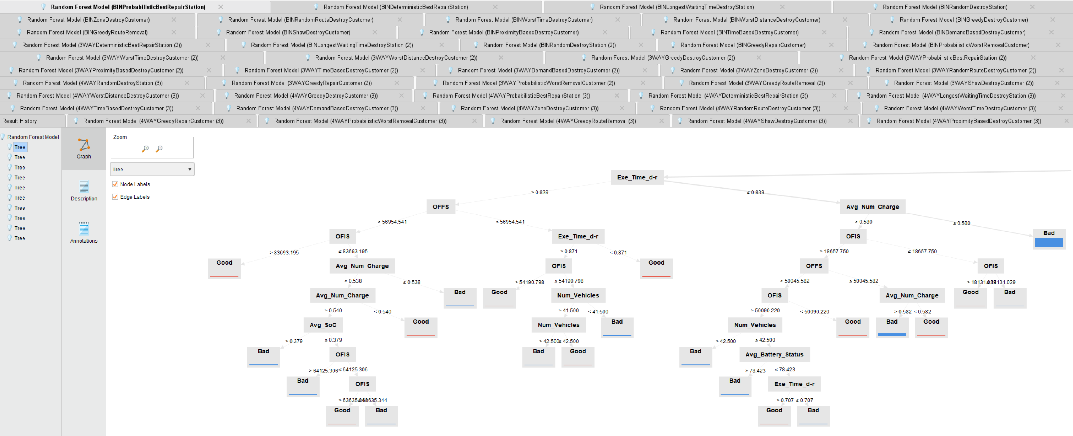
Visualization of trees
Example of tree

Slide 15
Conclusions
Modelled-ALNS is feasible and could bring to some improvements of performances
After some tests, both better and worse results were obtained than the original ALNS
BINARY / 3-WAY / 4-WAY approaches depend on the amount of data available and the goodness of the model (random forest is for his nature random)
Different seeds can also influence the results

